Slide 1
Self Driving Car Game
Capstone Project Warm-up:
Bhaviya Chopra(TL), Favour Eseagwu, Aswin Philip, Gagandeep Singh, Md Faiq Shaikh

Slide 2
Project Overview
Our goal is to develop an AI-powered Self Driving Game that is capable of sensing its environment and moving safely with little
or no human input .
Key Components:
User Profiling
Data Collection: Gather a comprehensive driving database.
Feature Extraction: Extract relevant features for analysis.
Machine Learning
Recommendation Generation
Feedback Loop
Continuous Learning.

Slide 3
Project Timeline
Phase 1: Data Collection and Feature Extraction (Weeks 1-4)
Phase 5: Continuous Learning (Ongoing)
Phase 2: User Profiling (Weeks 5-8)
Timeline
Phase 4: Recommendation Generation and Feedback Loop (Weeks 13-16)
Phase 3: Machine Learning Model (Weeks 9-12)

Slide 4
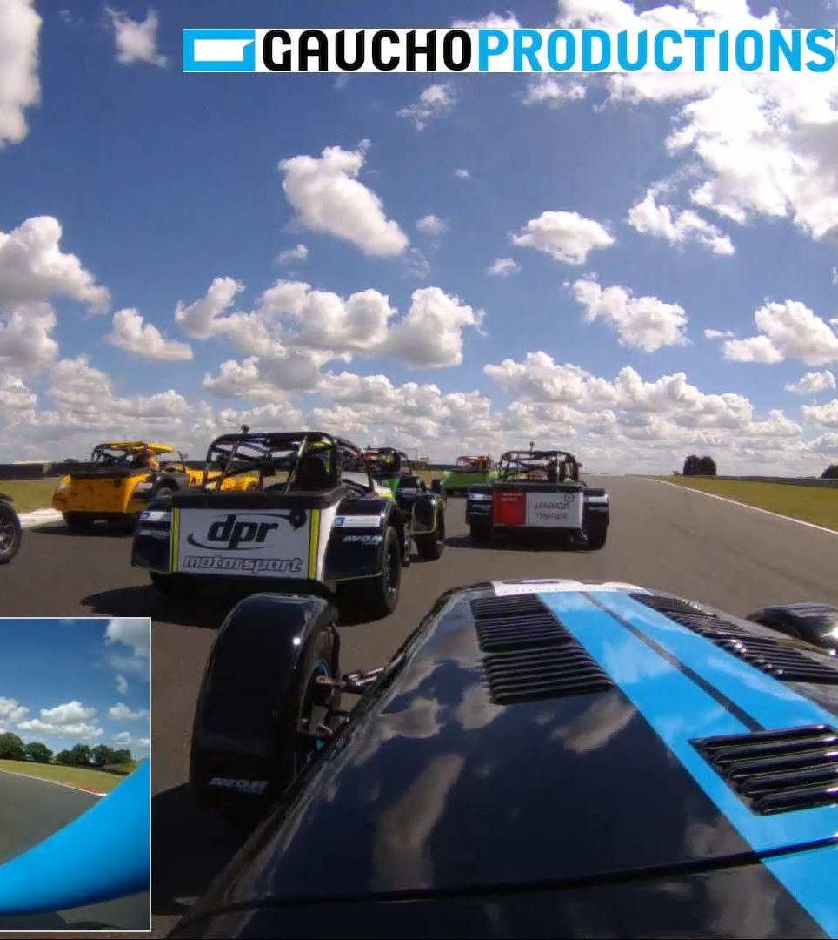
Conclusion
Aim to build a self driven game combine a variety of sensors to perceive their surroundings, such as radar, sonar, GPS, odometry and inertial measurement units to identify appropriate navigation paths, as well as obstacles and relevant signage.

